Slide 1

Mathematics for Programming

Slide 2
Recap
Basic Geometry
Points – Lines
Rectangle – Square
Circle
Coordinate system
2D and 3D – Distance between points
Sequence and Series
Finding sum of series

Slide 3
Unitary method
Unit: একক
Unitary: ঐকিক
Problem solving method:
Find value for single unit
Then multiply for necessary units

Slide 4
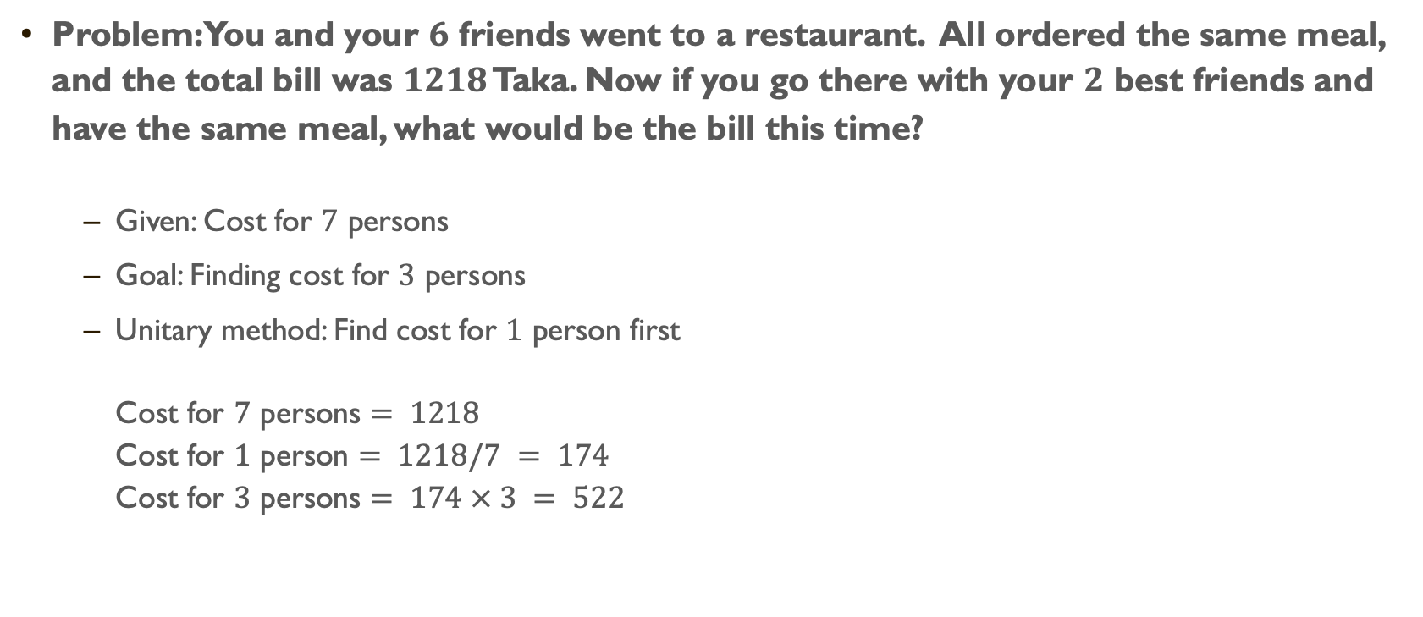
Unitary method
Problem: You and your $6$ friends went to a restaurant. All ordered the same meal, and the total bill was $1218$ Taka. Now if you go there with your $2$ best friends and have the same meal, what would be the bill this time?
Given: Cost for $7$ persons
Goal: Finding cost for $3$ persons
Unitary method: Find cost for $1$ person first Cost for $7$ persons $= 1218$ Cost for $1$ person $= 1218/7 = 174$ Cost for $3$ persons $= 174 × 3 = 522$

Slide 5
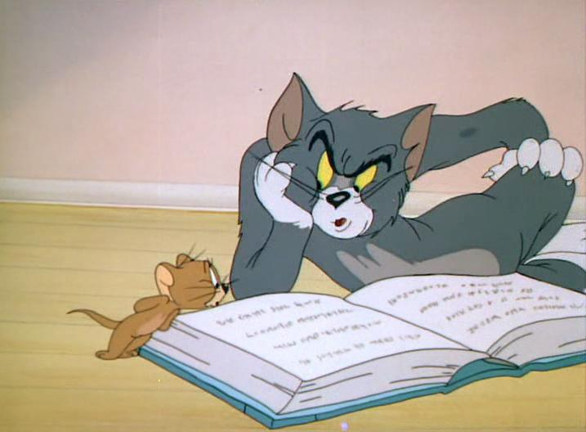
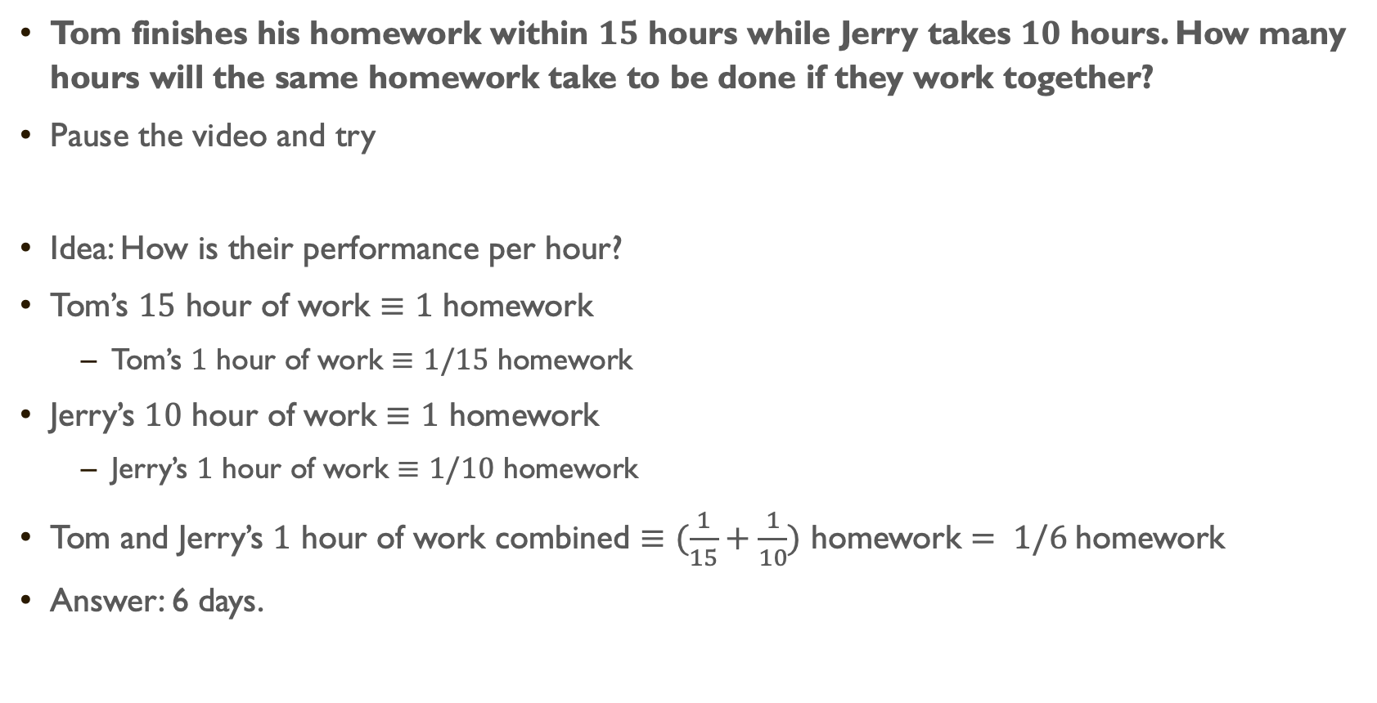
Unitary method
Tom finishes his homework within $15$ hours while Jerry takes $10$ hours. How many hours will the same homework take to be done if they work together?
Pause the video and try
Idea: How is their performance per hour?
Tom’s $15$ hour of work $≡$ $1$ homework
Tom’s $1$ hour of work $≡$ $1/15$ homework
Jerry’s $10$ hour of work $≡$ $1$ homework
Jerry’s $1$ hour of work $≡$ $1/10$ homework
Tom and Jerry’s $1$ hour of work combined $≡$ $(\frac{1}{15}+\frac{1}{10})$ homework $= 1/6$homework
Answer: 6 days.

Slide 6
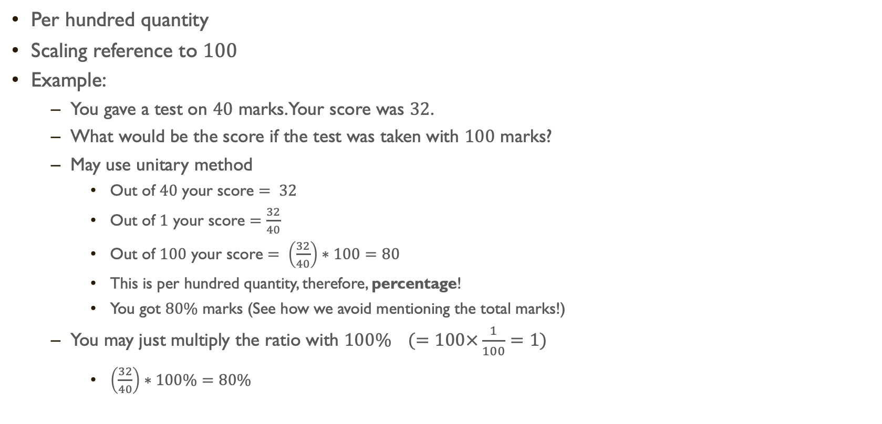
Percentage
Per hundred quantity
Scaling reference to $100$
Example:
You gave a test on $40$ marks. Your score was $32$.
What would be the score if the test was taken with $100$ marks?
May use unitary method
Out of $40$ your score $= 32$
Out of $1$ your score $=\frac{32}{40}$
Out of $100$ your score $= \left(\frac{32}{40}\right)∗100=80$
This is per hundred quantity, therefore, percentage!
You got $80\%$ marks (See how we avoid mentioning the total marks!)
You may just multiply the ratio with $100\% (=100×\frac{1}{100}=1)$
$\left(\frac{32}{40}\right)∗100\%=80\%$

Slide 7
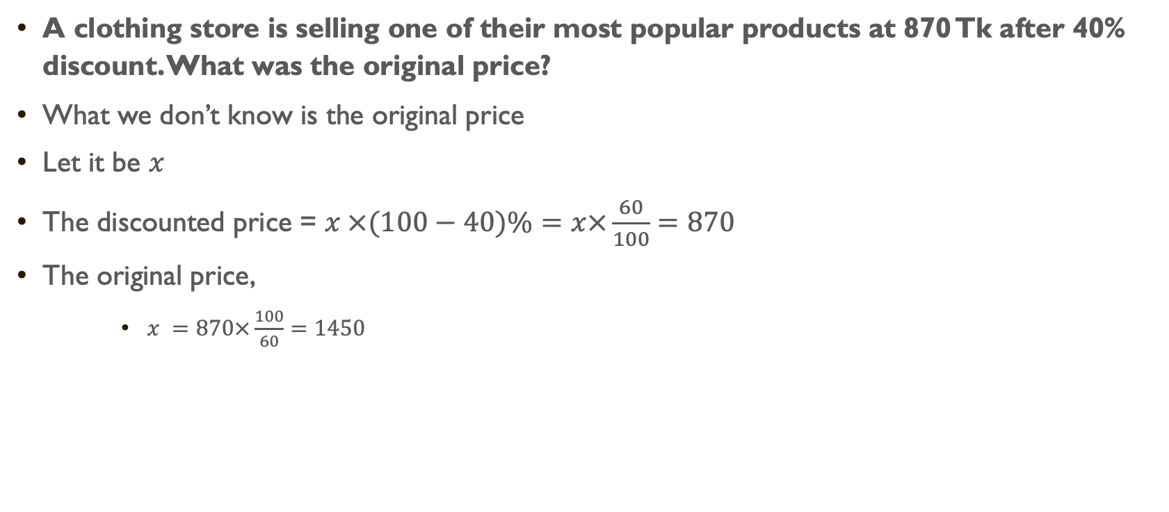
Percentage Problem
A clothing store is selling one of their most popular products at 870 Tk after 40% discount. What was the original price?
What we don’t know is the original price
Let it be $x$
The discounted price = $x ×(100−40)\%=x×\frac{60}{100}=870$
The original price,
$x =870×\frac{100}{60}=1450$

Slide 8
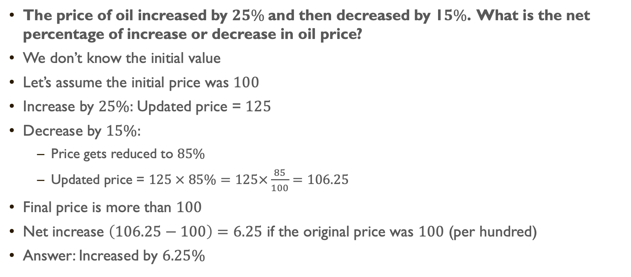
Percentage Problem
The price of oil increased by $25\%$and then decreased by 1$5\%$. What is the net percentage of increase or decrease in oil price?
We don’t know the initial value
Let’s assume the initial price was $100$
Increase by $25\%:$Updated price = $125$
Decrease by $15\%:$
Price gets reduced to $85\%$
Updated price = $125 × 85\%=125×\frac{85}{100}=106.25$
Final price is more than $100$
Net increase $\left(106.25−100\right)=6.25$ if the original price was $100$ (per hundred)
Answer: Increased by $6.25\%$

Slide 9

capital and Interest
Capital
Interest
Interest rate
Per 100 taka
Per 1 year (3 months, 6 months are also common)
Simple interest vs compound interest
Simple interest
$I=P×n×r$
Interest = Capital x Time unit x Interest rate

Slide 10
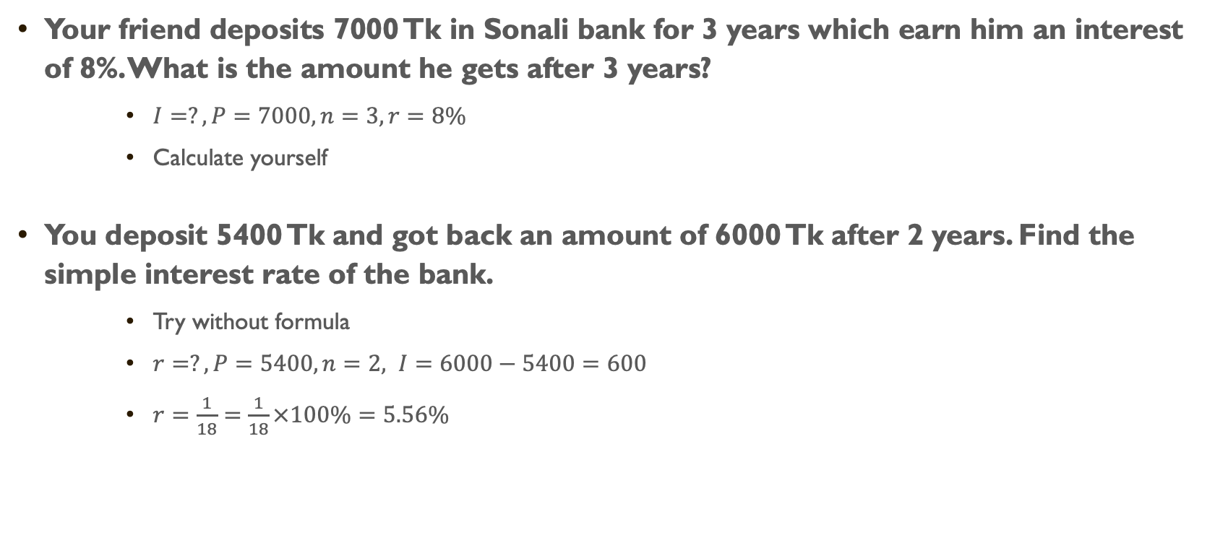
Simple interest
Your friend deposits 7000 Tk in Sonali bank for 3 years which earn him an interest of 8%. What is the amount he gets after 3 years?
$I=?, P=7000, n=3, r=8\%$
Calculate yourself
You deposit 5400 Tk and got back an amount of 6000 Tk after 2 years. Find the simple interest rate of the bank.
Try without formula
$r=?, P=5400, n=2, I=6000−5400=600$
$r=\frac{1}{18}=\frac{1}{18}×100\%=5.56\%$

Slide 11
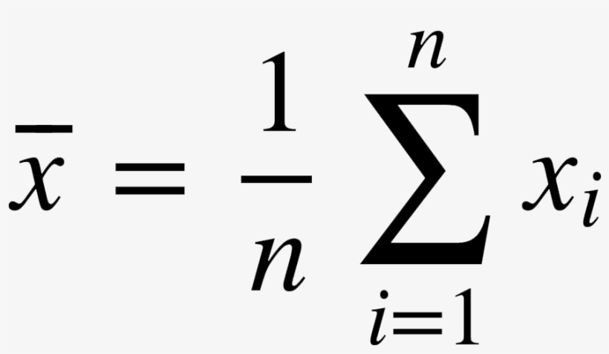
Mean & median
Mean
Given some numbers
Take the sum of them
Divide by the count of numbers
You get the mean or average
Can you interpret the formula on right?

Slide 12
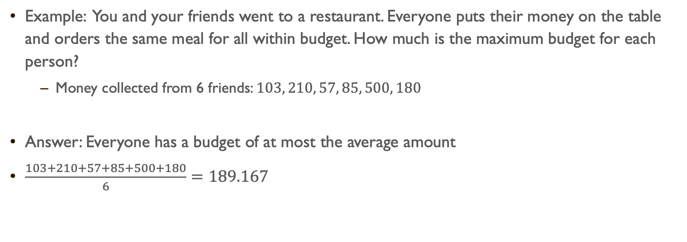
Mean
Example: You and your friends went to a restaurant. Everyone puts their money on the table and orders the same meal for all within budget. How much is the maximum budget for each person?
Money collected from 6 friends: $103, 210, 57, 85, 500, 180$
Answer: Everyone has a budget of at most the average amount
$\frac{103+210+57+85+500+180}{6}=189.167$

Slide 13
Mean & median
What does it mean to take the middle number?
Say your median value is X
Then ~50% of the values are less than X
And ~50% of the values are greater than X
Median
Given some numbers
Sort them in ascending order
Take the number found at the middle
If count is odd
Middle one is unique
If count is even
There are two elements in the middle
Take average of those two
8, 7, 3, 2, 10
Sort: 2, 3, 7, 8, 10
Median: 7
8, 7, 3, 2, 10, 1
Sort: 1, 2, 3, 7, 8, 10
Median: (3+7)/2=5

Slide 14
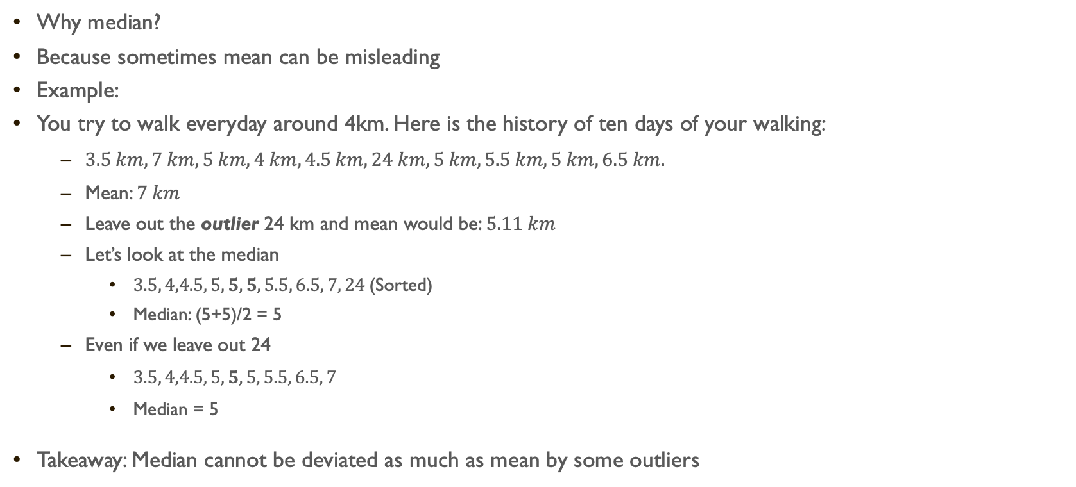
Median
Why median?
Because sometimes mean can be misleading
Example:
You try to walk everyday around 4km. Here is the history of ten days of your walking:
$3.5 km,7 km, 5 km, 4 km, 4.5 km,24 km, 5 km, 5.5 km, 5 km, 6.5 km.$
Mean: $7 km$
Leave out the outlier 24 km and mean would be: $5.11 km$
Let’s look at the median
$3.5, 4,4.5, 5, 5, 5, 5.5, 6.5, 7, 24$(Sorted)
Median: (5+5)/2 = 5
Even if we leave out 24
$3.5, 4,4.5, 5, 5, 5, 5.5, 6.5, 7$
Median = 5
Takeaway: Median cannot be deviated as much as mean by some outliers

Slide 15
Summary
Unitary method and percentage
Solving problems
Interest rate and related problems
Mean and Median

